Slide 1


K-Challenge
Building healthy and sustainable habits

Slide 2

Utilize what you already have. Discover
delicious new recipes. Take part in exciting challenges. Make healthier and more sustainable decisions.
All directed by your own data.

Slide 3
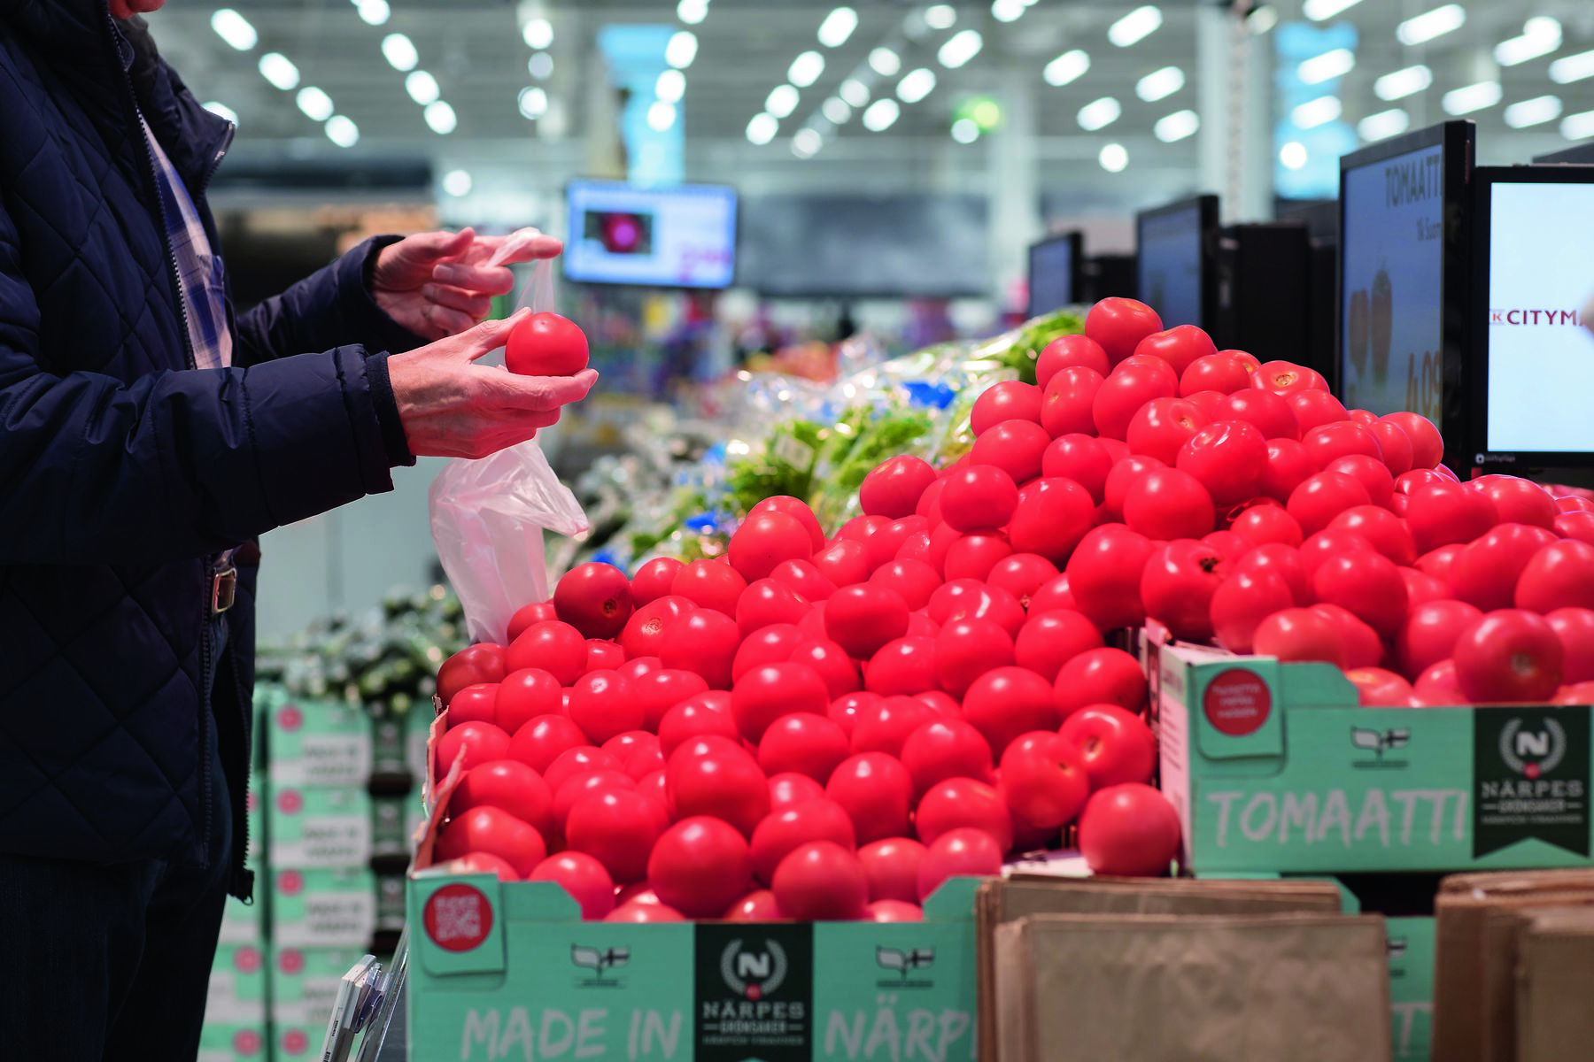
When food isn’t purchased or used wisely, ingredients can end up in a bin instead of on a plate - in Finland, up to 160 million kilograms of food is wasted each year after it’s been purchased.

Slide 4

K-Challenge is an extension for the web app K-Ruoka, helping customers keep track of and utilize the ingredients they have on hand by suggesting recipes. It can also inform customers when the ingredients they need or purchase the most go on sale.

Slide 5

K-Challenges encourage a change in habits. For example, improving diet to improve health, preventing food waste by using what’s on hand, or choosing ingredients that are in season. Rewards encourage users to complete challenges and come back for more.

Slide 6

Push notifications alert customers when their favorite items are on sale at the shops they frequent - helping prevent food waste in shops. Notifications can also shed light on alarming patterns, such as purchasing large quantities of ingredients that are often wasted, and offer tips and solutions.

Slide 7

Challenges that reward customer loyalty and utilize customer data can not only support sustainable decision making, but boost shop sales and brand loyalty as a whole. It can also provide shop owners with more insight about how their regular customers behave.

Slide 8

What’s under the hood?
Front end powered by Javascript, CSS and HTML on a VueJS framework
Back end powered by Kesko APIs and NodeJS
Graphics based on client media, utilizing what exists for smooth integration

Slide 9





Design and
Back end
Former
Customer
Service
Tech assistant
Former Computer
Electronics Engineer
Front end
Former
Social
Counselor
Tech Lead and API
Former
English
Teacher
Team Lead
Former
Content
Manager

